Slide 1




DATA DISSEMINATION
Version 1.0

Slide 2
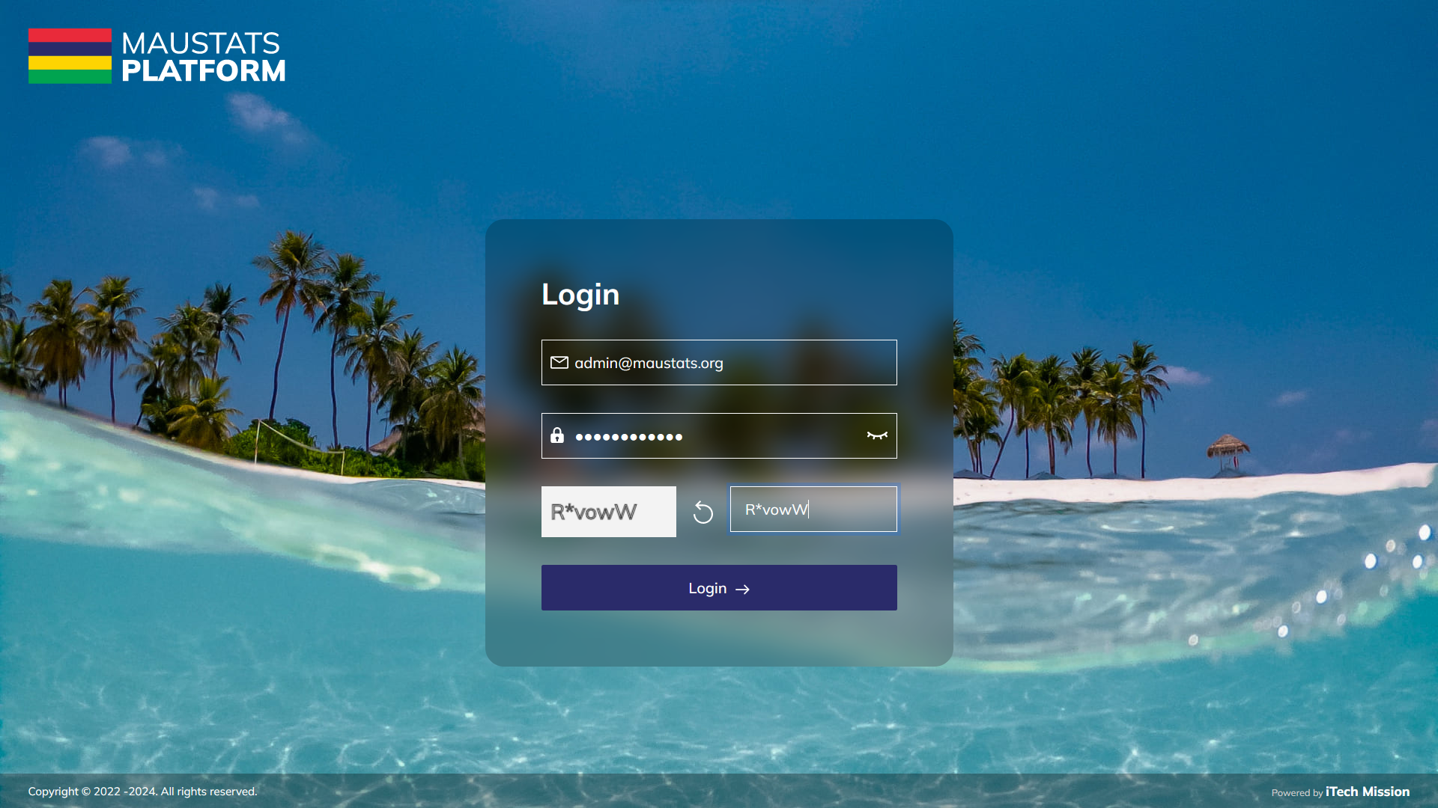
LOGIN
Login using valid credentials to access the Data dissemination module.

Slide 3
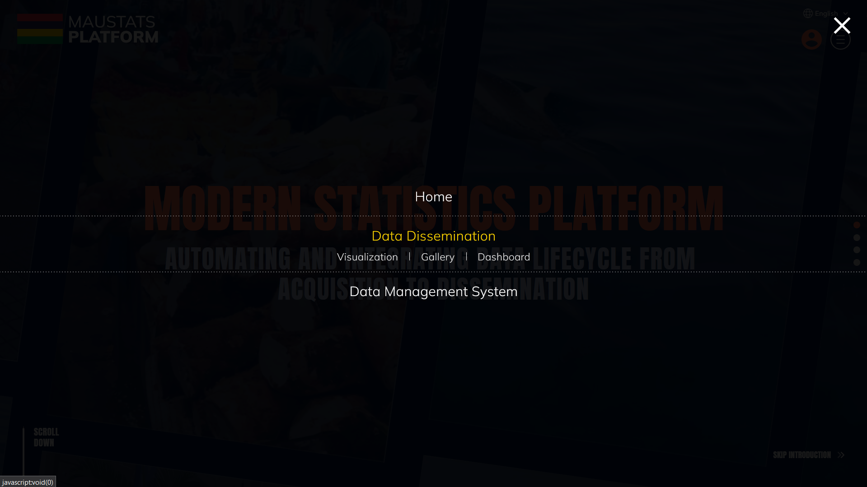
DATA DISSEMINATION
To access published primary datasets, click on burger menu and select Data Dissemination.

Slide 4

DATA DISSEMINATION
Visualization
Gallery
Dashboard

Slide 5

1
VISUALIZATION

Slide 6
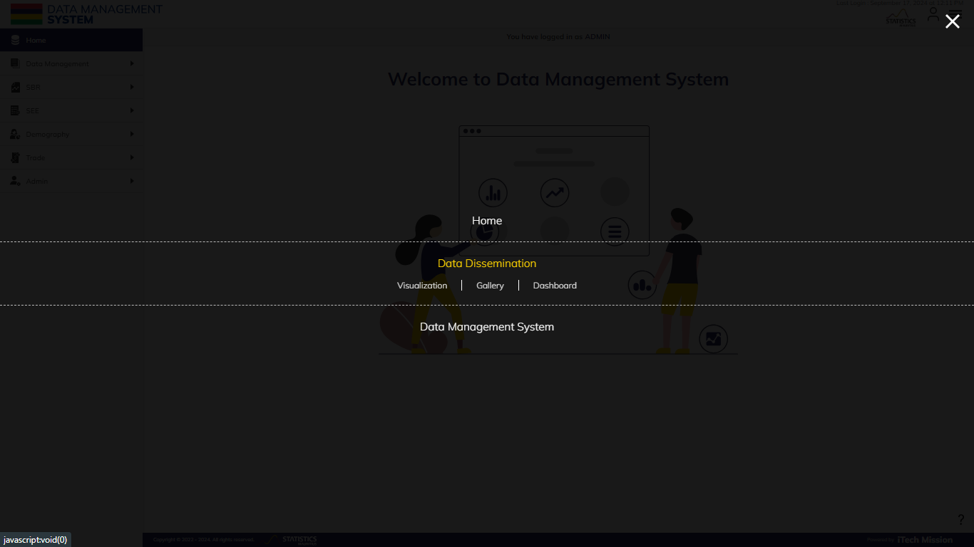
VISUALIZATION
Select Visualization from the Data Dissemination Menu.

Slide 7
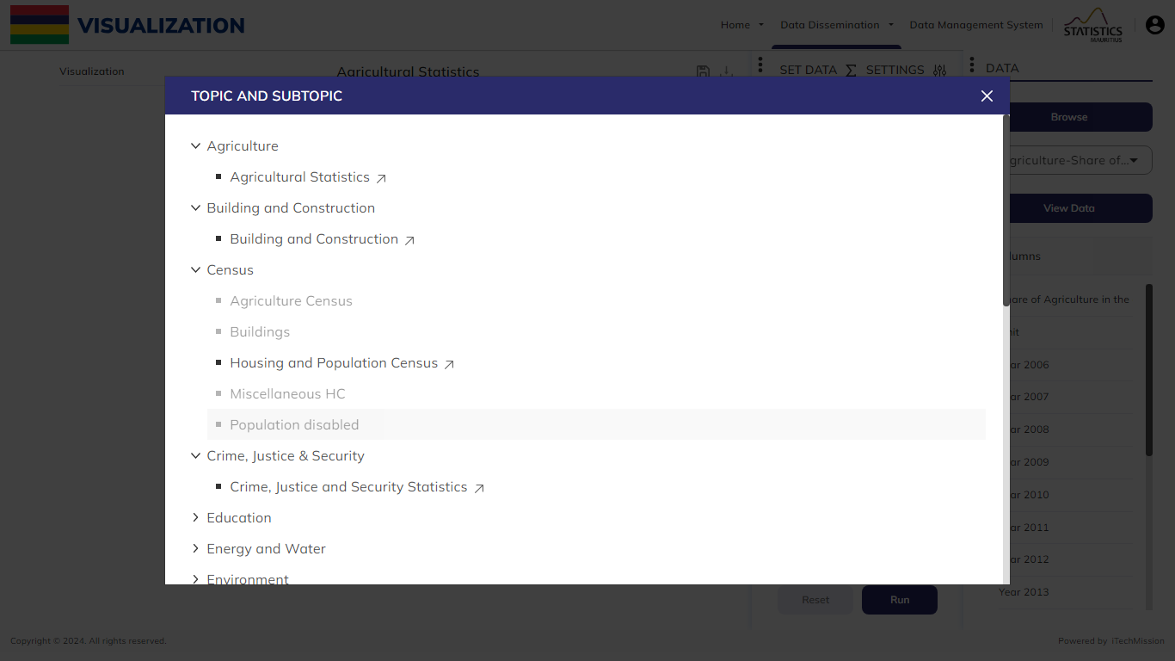
VISUALIZATION
Select one of the Topic and Subtopic.

Slide 8
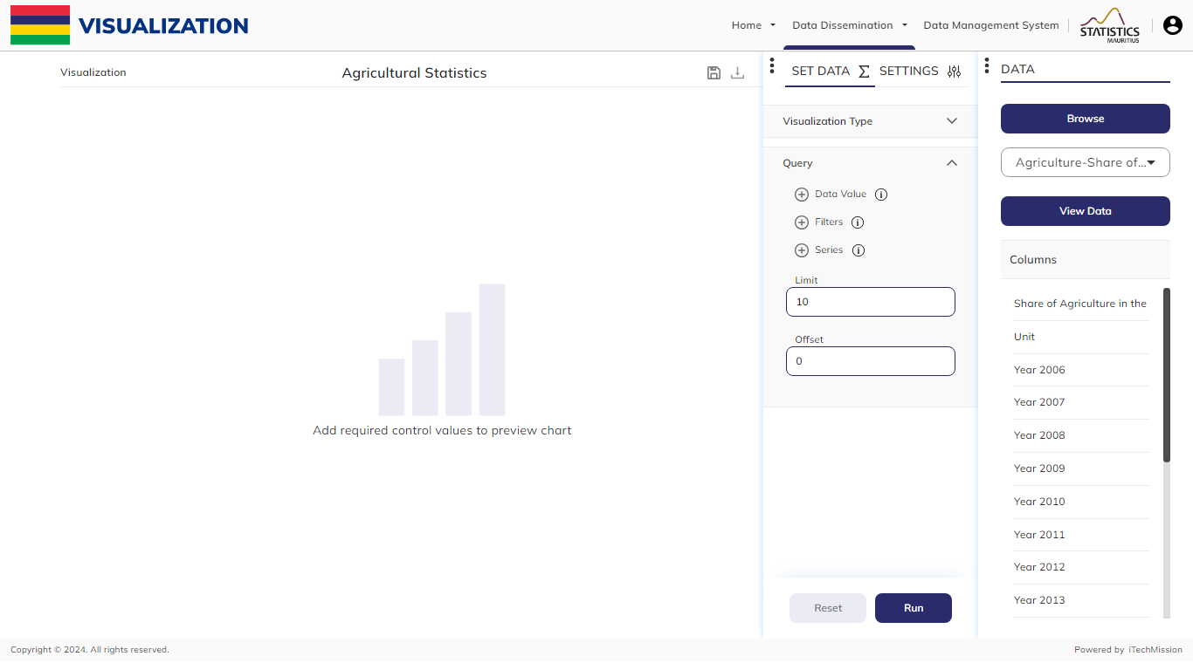
VISUALIZATION
In the Data widget, browse the data file and select the selected data file(s) columns.

Slide 9
VISUALIZATION
Click on the View Data button to view the column List and data in a tabular view.

Slide 10
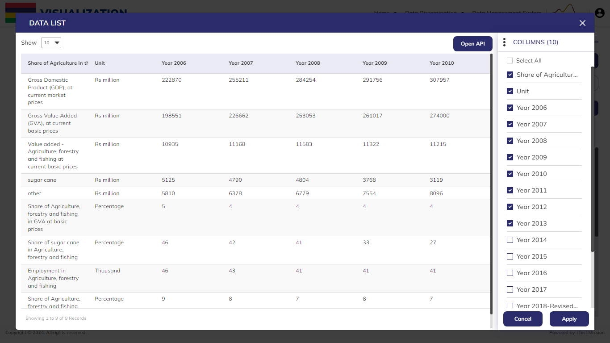
VISUALIZATION
Click on the Open API to get the request and payload API.

Slide 11
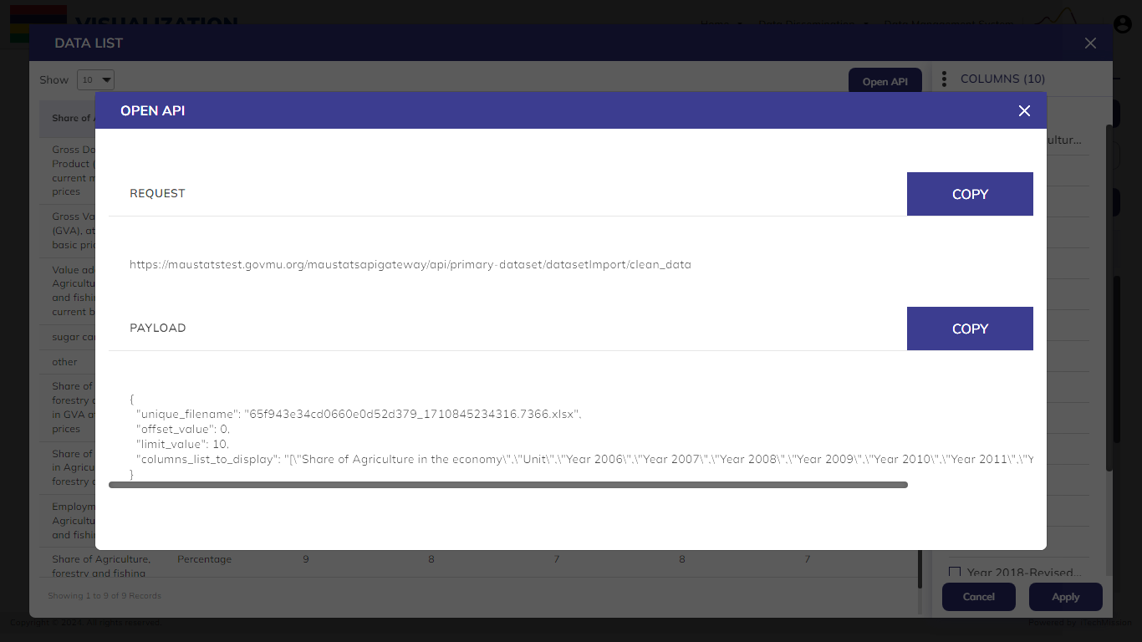
VISUALIZATION
Copy and use the Request and Payload API.

Slide 12
VISUALIZATION
Add or remove the Columns and click Apply

Slide 13
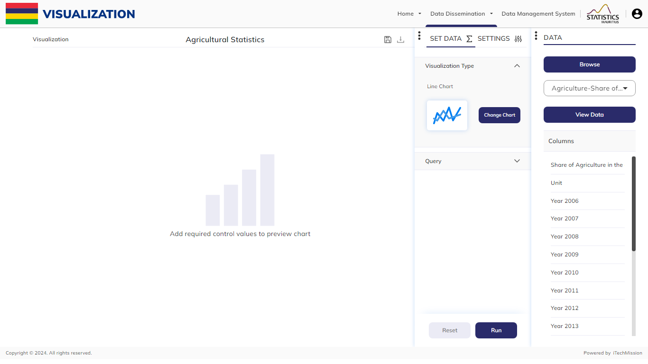
VISUALIZATION
Set the Visualization Type of the chart by clicking Change Chart.

Slide 14
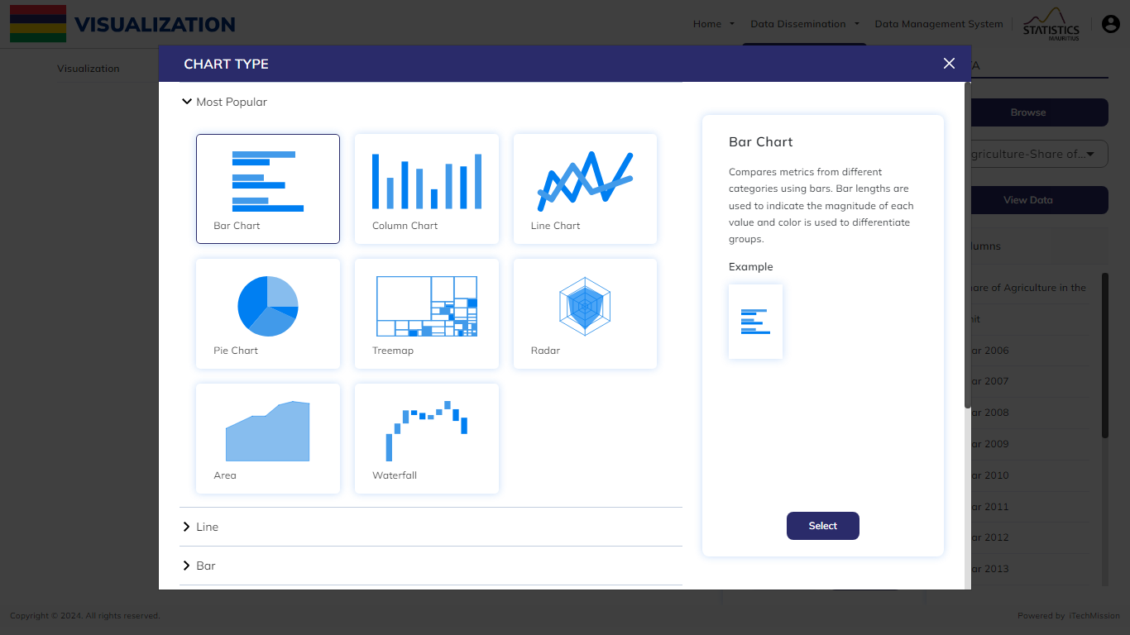
VISUALIZATION
Select Chart Type and click on the Select button.

Slide 15
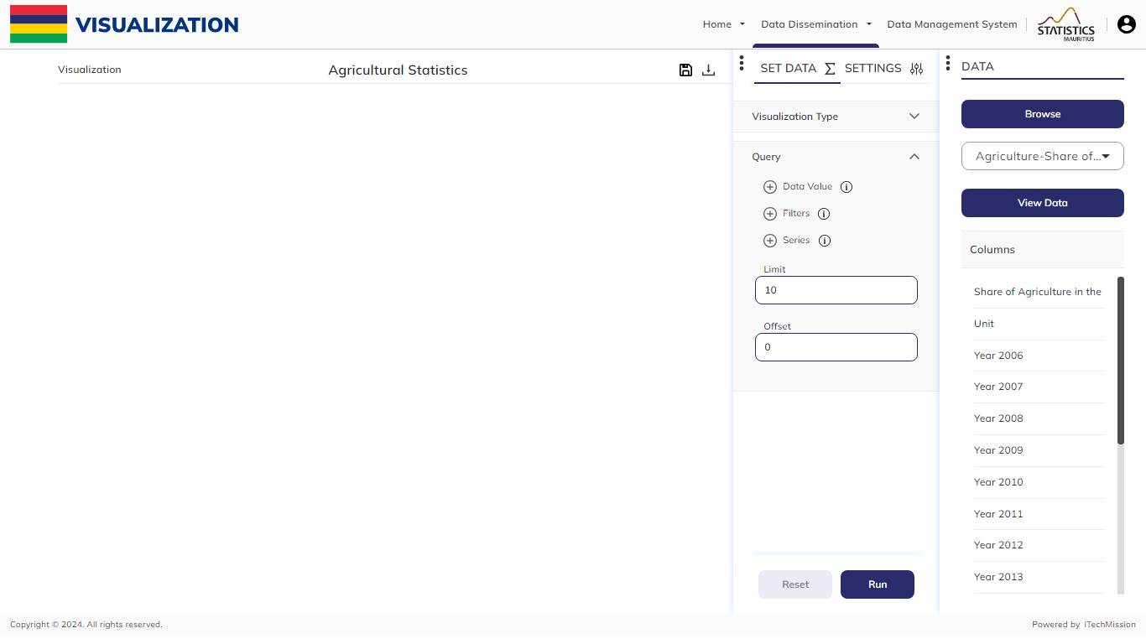
VISUALIZATION
Set Query, by selecting Data Value, Filter, Series, Limit, and Offset.

Slide 16
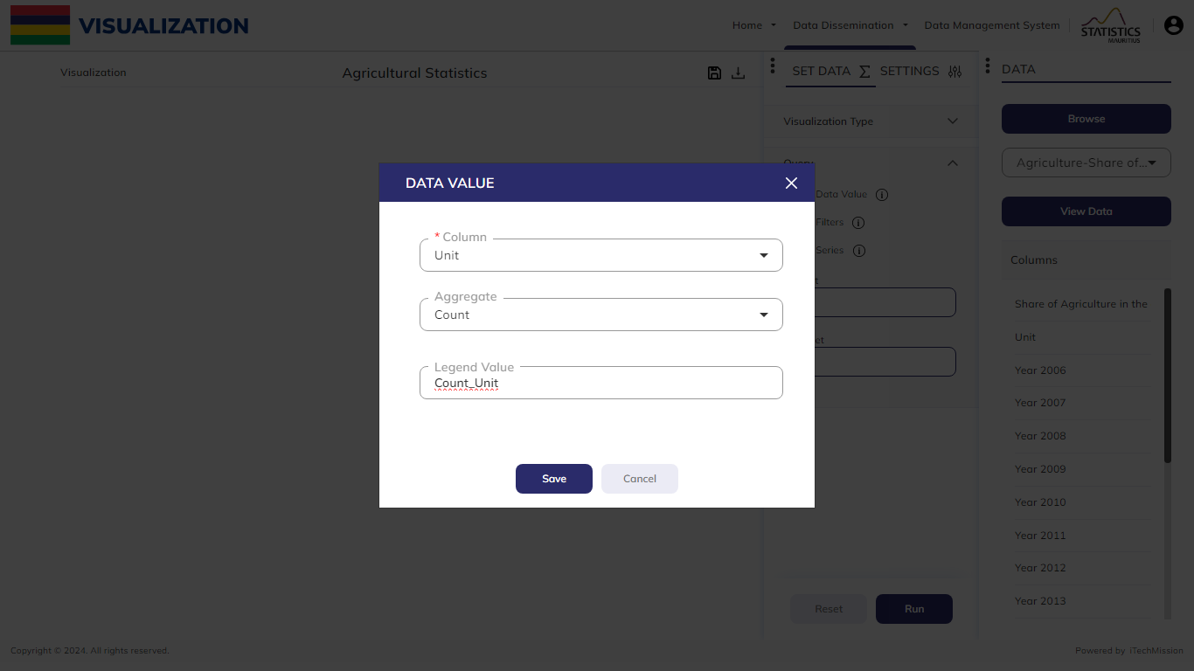
VISUALIZATION
In the Data Value section, select the column and aggregate, then enter the Legend Value to choose the Data Value. Finally, click Save.

Slide 17
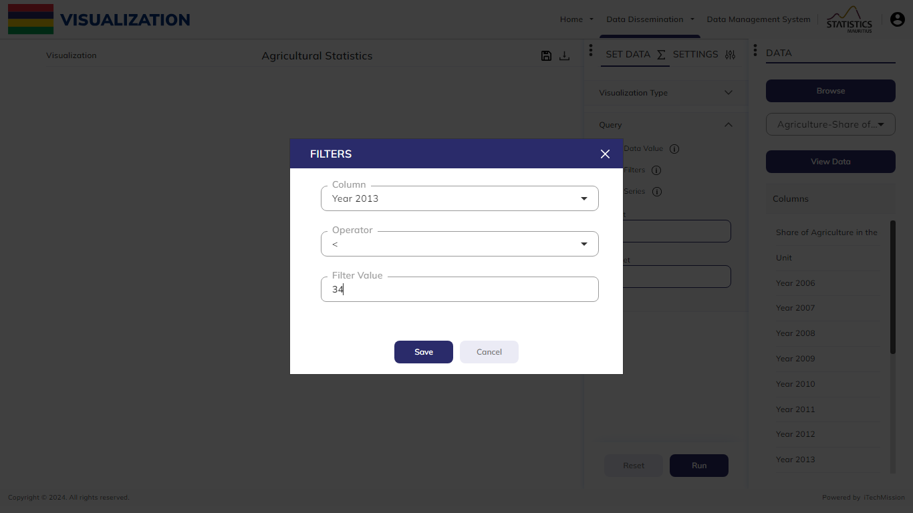
VISUALIZATION
In the Filters section, choose the Column, then the Operator, and enter the Filter Value. Finally, click Save.

Slide 18
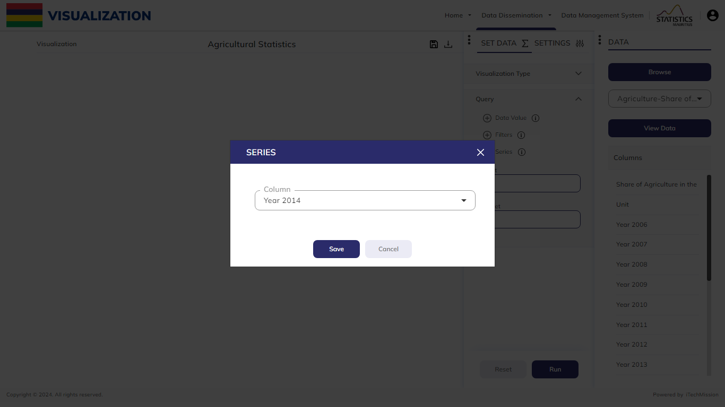
VISUALIZATION
Select the Series Column of the data.

Slide 19
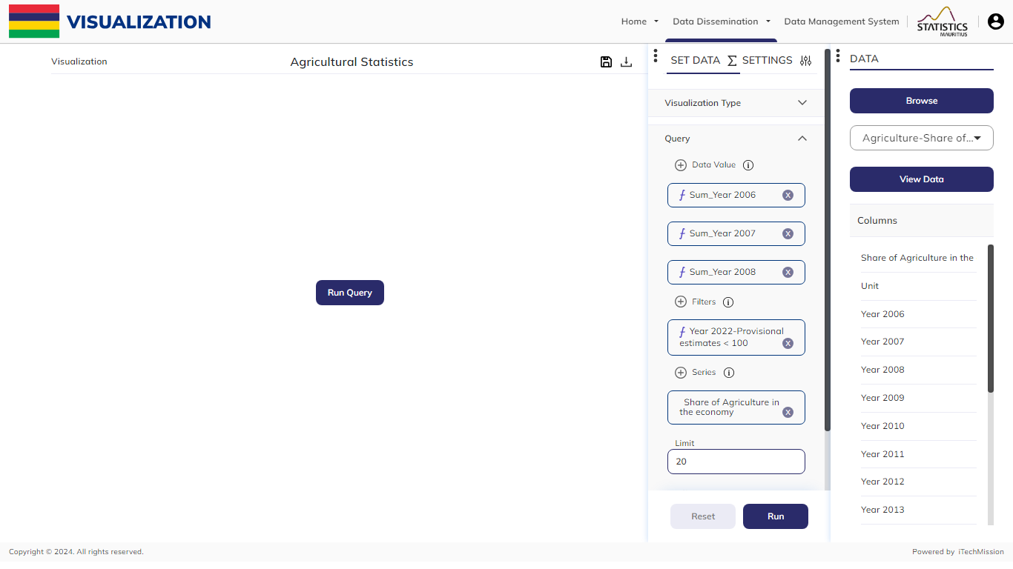
VISUALIZATION
Click on the Run Query button to create a visualization of the set query.

Slide 20
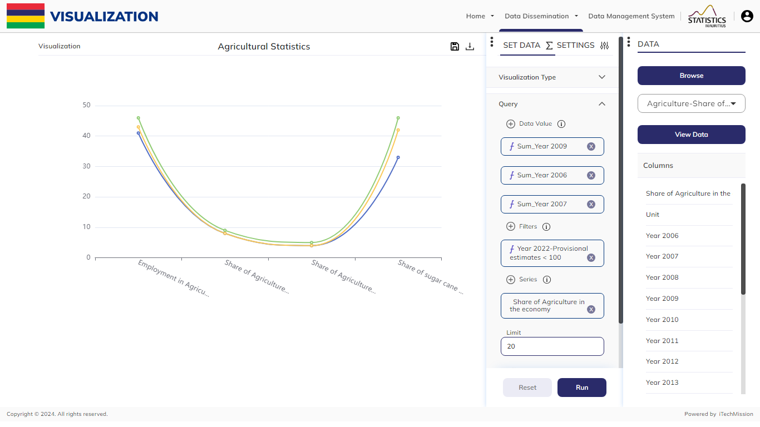
VISUALIZATION
Click on Settings to change the appearance of the chart.

Slide 21
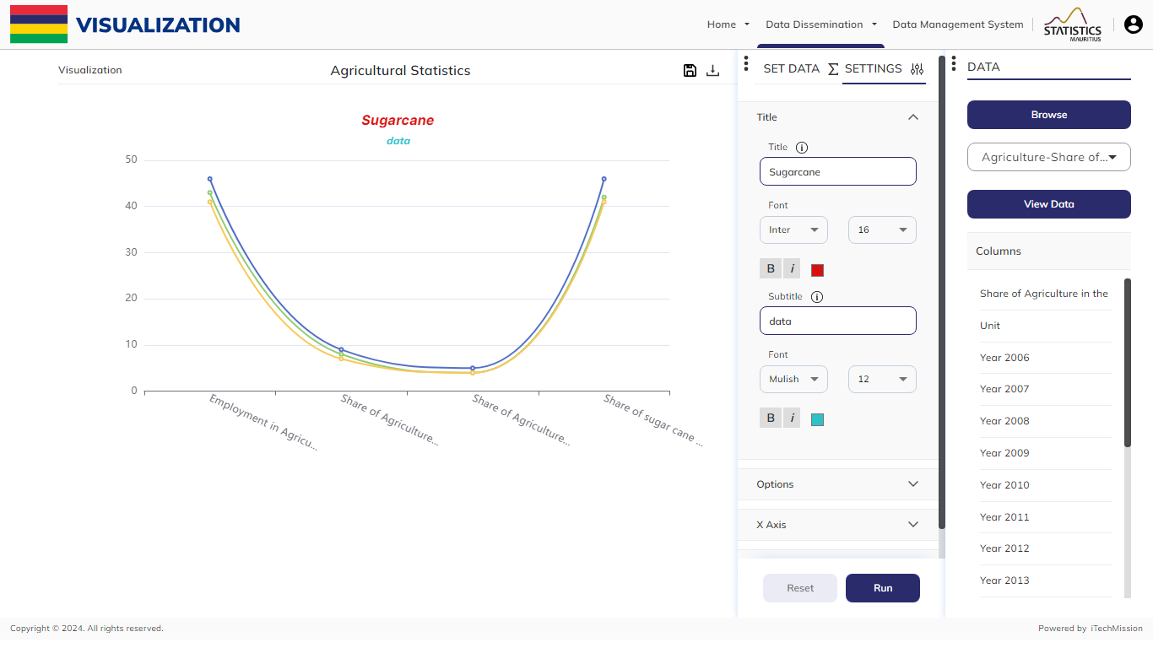
VISUALIZATION
Add Title and Subtitle to the graph and format it accordingly.

Slide 22
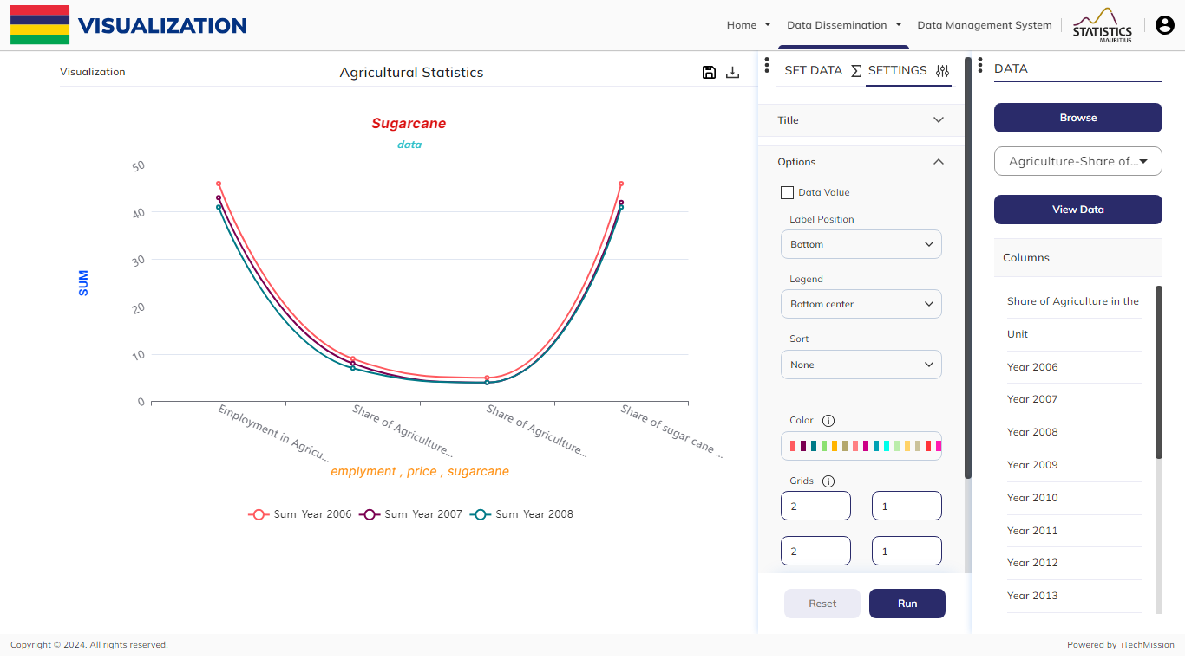
VISUALIZATION
Change Label, Legend Position and Sort the data with the help of the Options menu.

Slide 23
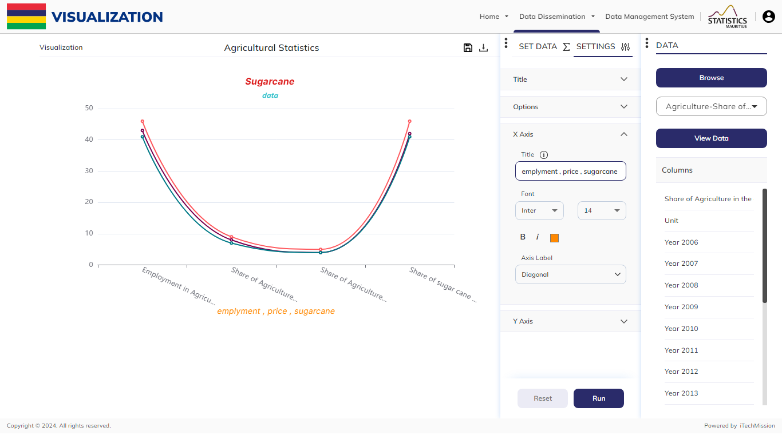
VISUALIZATION
Give title to X-axis and Format Title and Axis Label.

Slide 24

VISUALIZATION
Give title to Y-axis and Format Title and Axis Label.

Slide 25
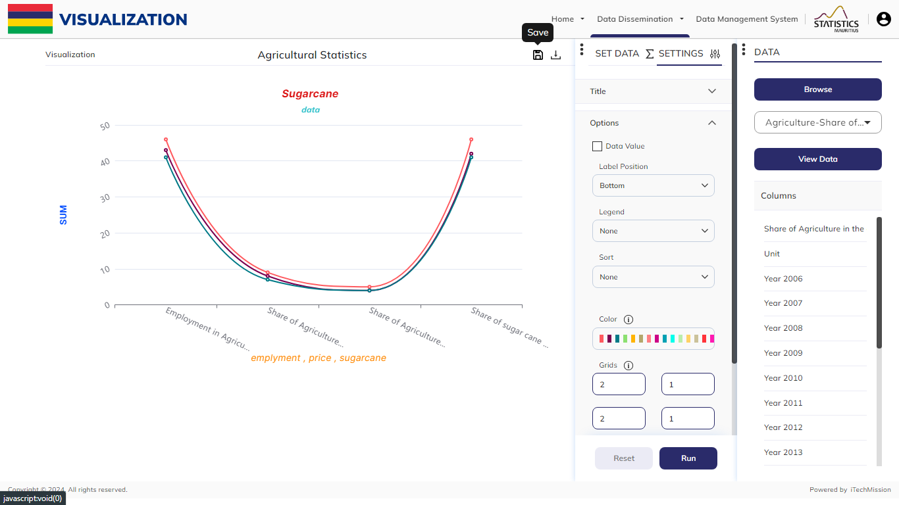
VISUALIZATION
Click on the Save button to save the visualization in the gallery.

Slide 26
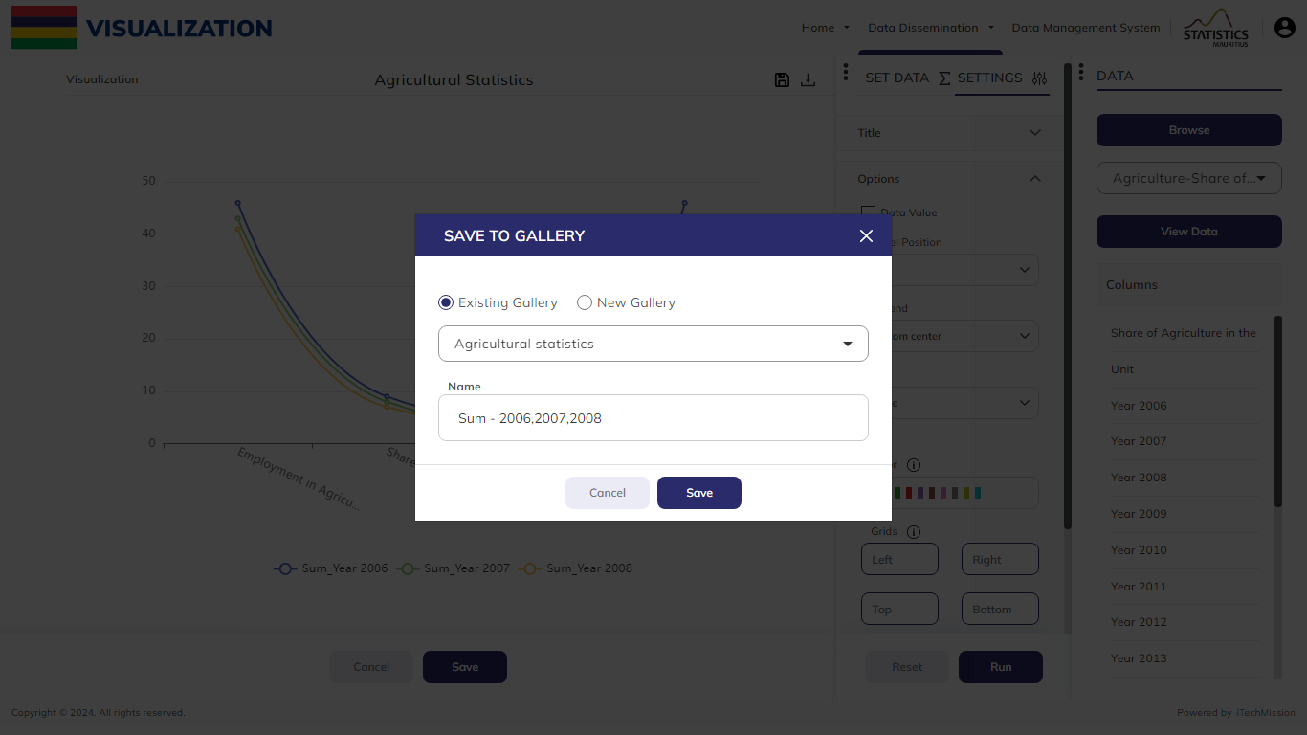
GALLERY
For Existing Gallery, select the Gallery Name and Enter the name of the chart, then click Save

Slide 27
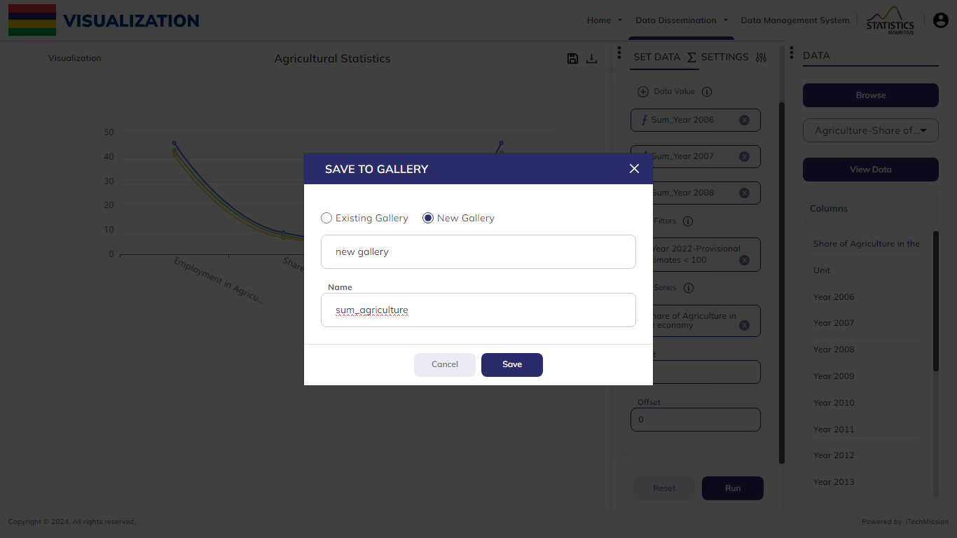
GALLERY
For New Gallery, enter the gallery name and the name of the chart, then click Save

Slide 28
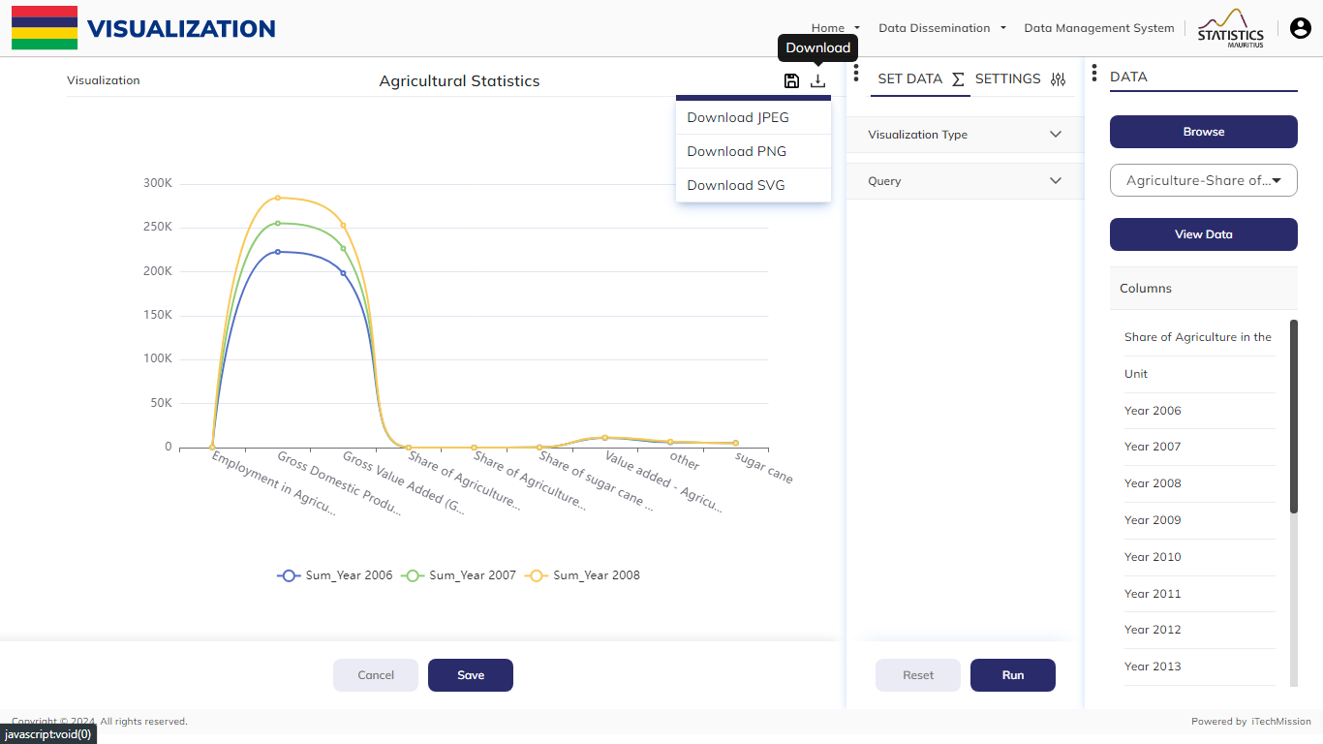
VISUALIZATION
Click on the Download button to download the visualization in JPEG, PNG or SVG format.

Slide 29
2
GALLERY

Slide 30
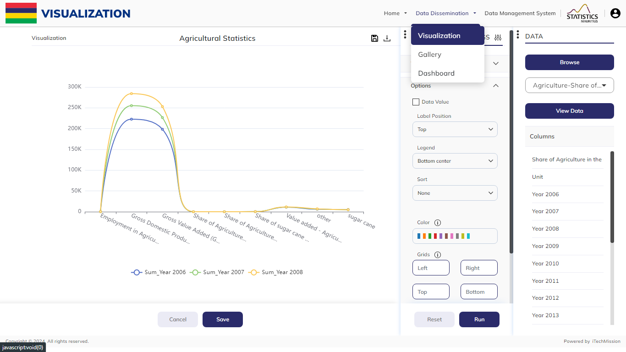
GALLERY
Navigate Gallery from the Data Dissemination menu on top.

Slide 31

GALLERY
Select Gallery from the Data Dissemination Menu present in the burger menu.

Slide 32
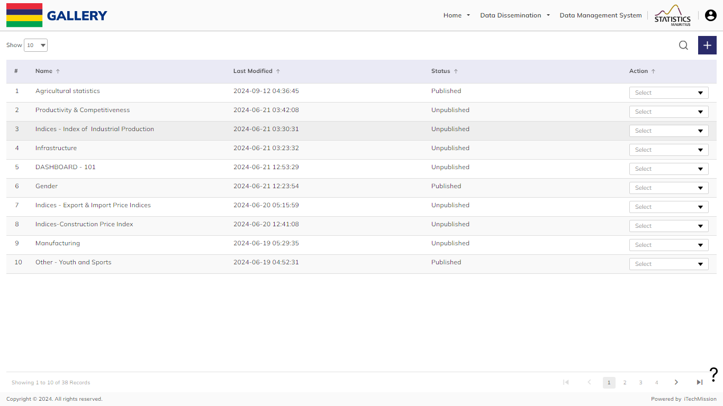
GALLERY
Click on Plus button to create a new gallery.

Slide 33
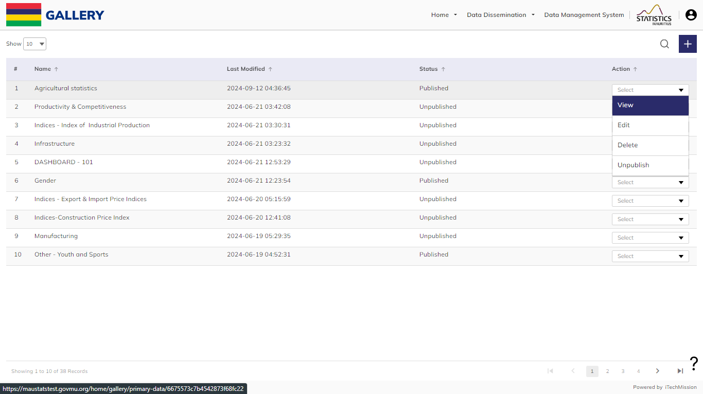
GALLERY
Click on the action dropdown to View, Edit, Delete, and Publish/Unpublish the selected gallery

Slide 34
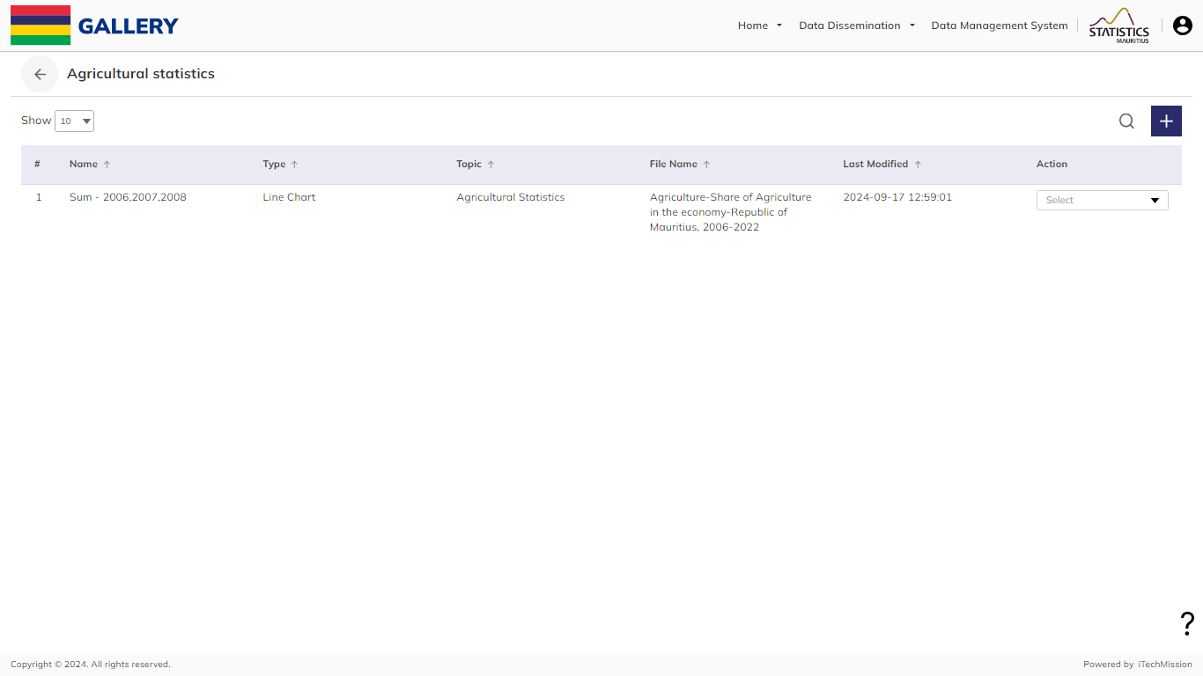
GALLERY
Click View to view charts for the selected gallery.

Slide 35
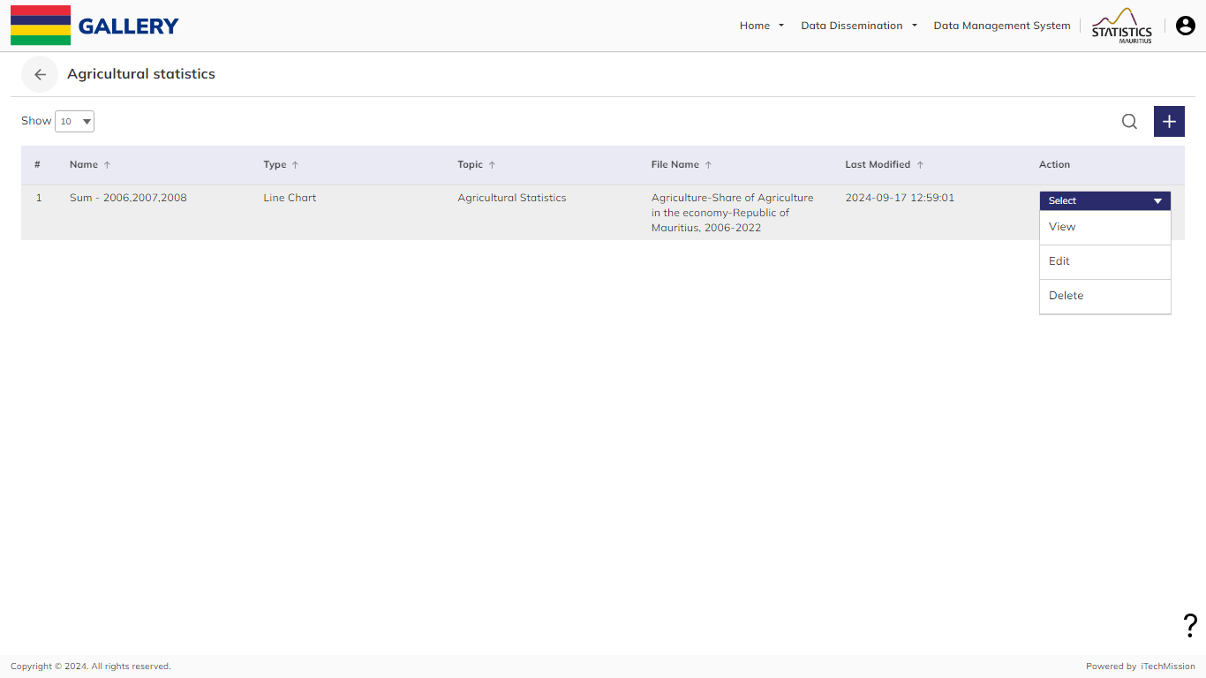
GALLERY
Click on the action dropdown to View, Edit, and Delete the chart.

Slide 36
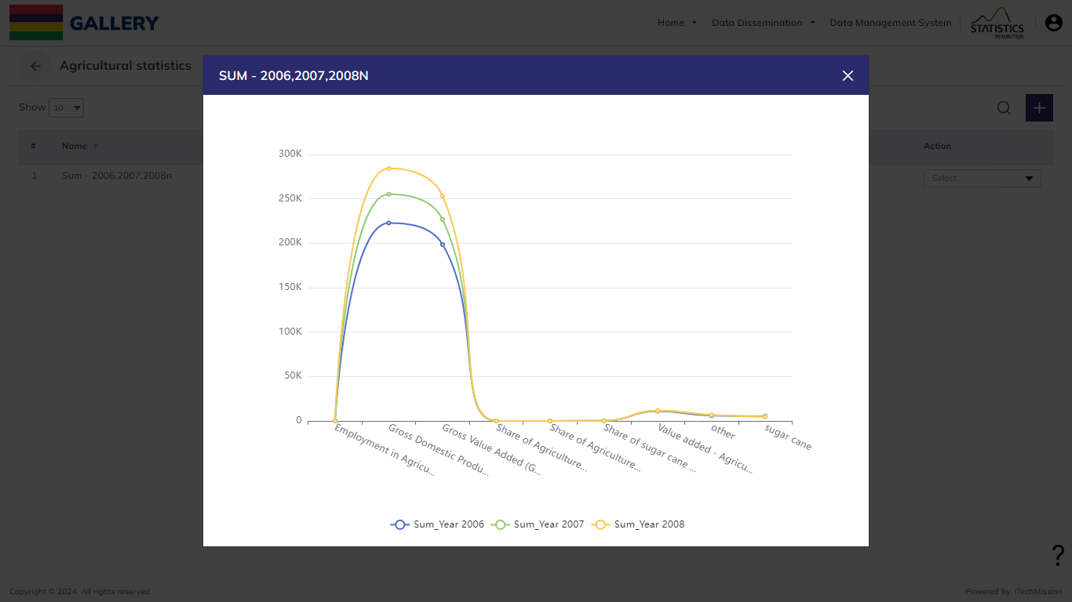
GALLERY
Click View to see the chart.

Slide 37
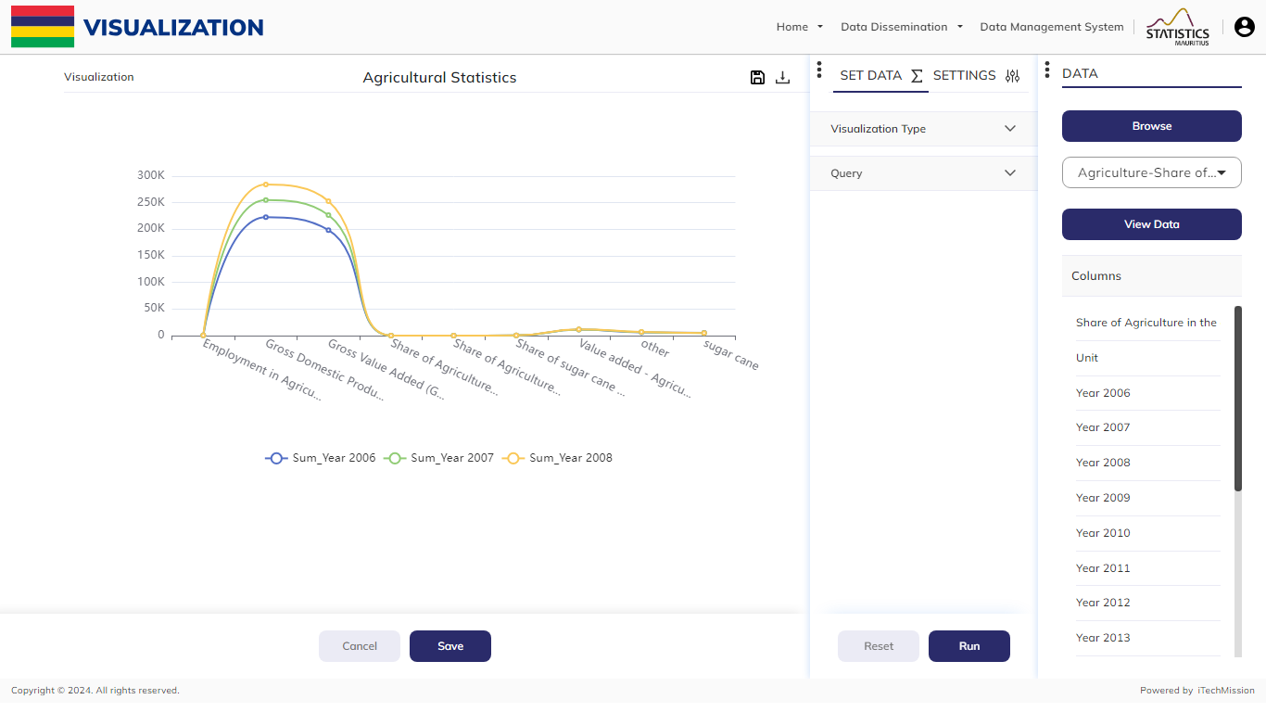
GALLERY
Click edit to make changes to the existing chart. Once the editing is done click Save/Cancel.

Slide 38
3
DASHBOARD

Slide 39
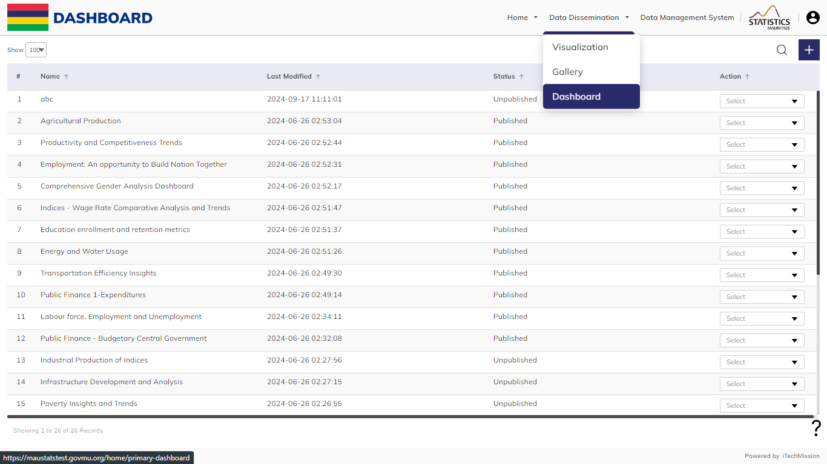
DASHBOARD
Navigate the Dashboard from the Data Dissemination menu on top.

Slide 40
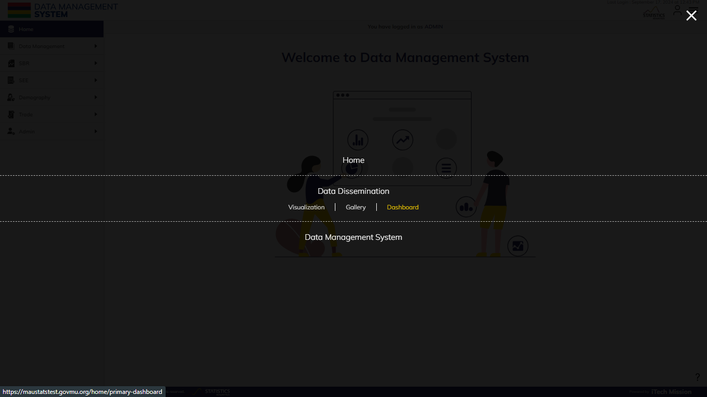
DASHBOARD
Select Dashboard from the Data Dissemination Menu present in the burger menu.

Slide 41
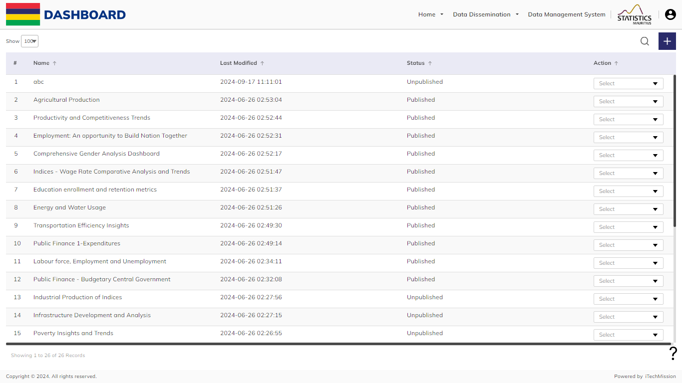
DASHBOARD
Click on Plus button to create a New Dashboard.

Slide 42
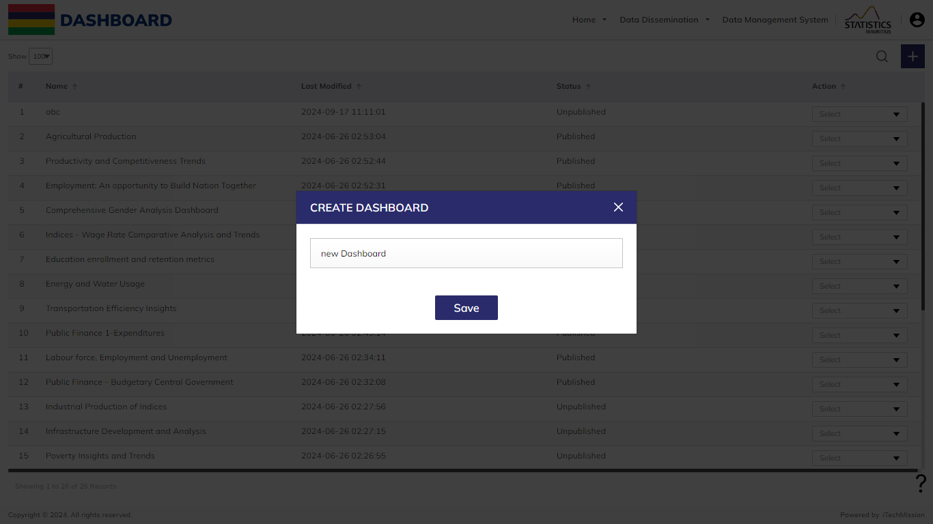
DASHBOARD
Give a name to the dashboard and save it.

Slide 43
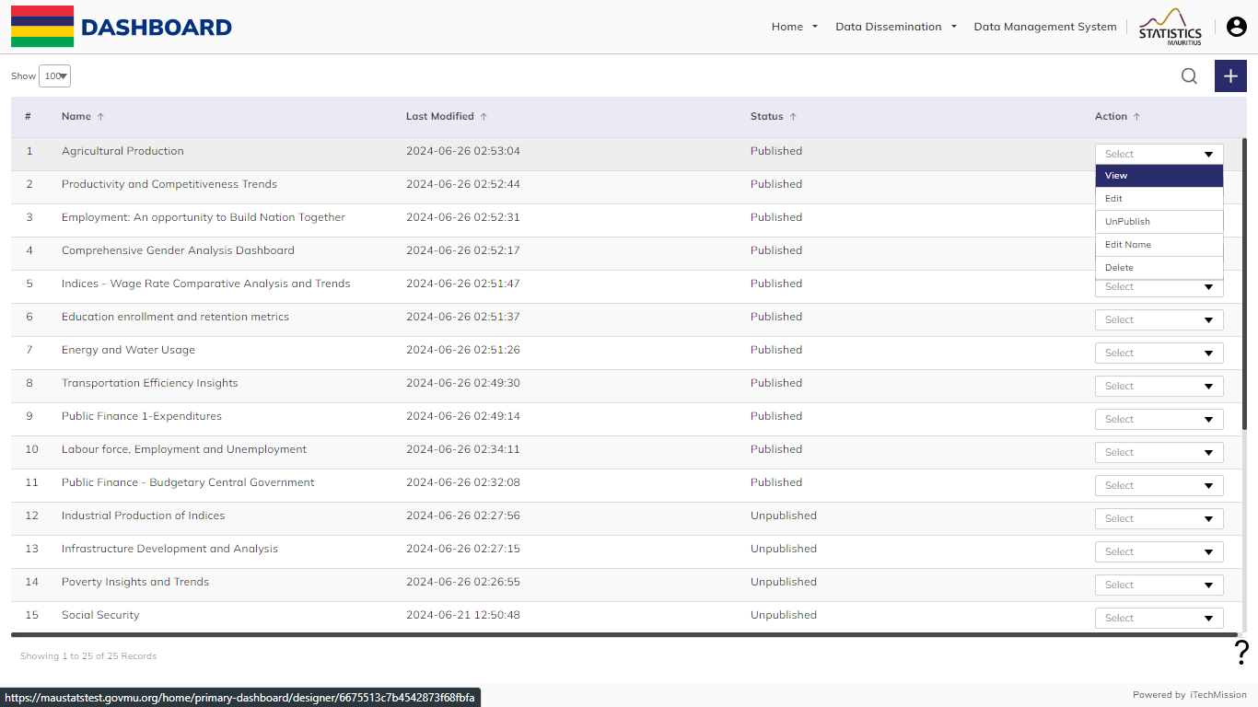
DASHBOARD
Click on the action dropdown to View, Edit, Publish/Unpublish, Edit Name, and Delete the dashboard.

Slide 44
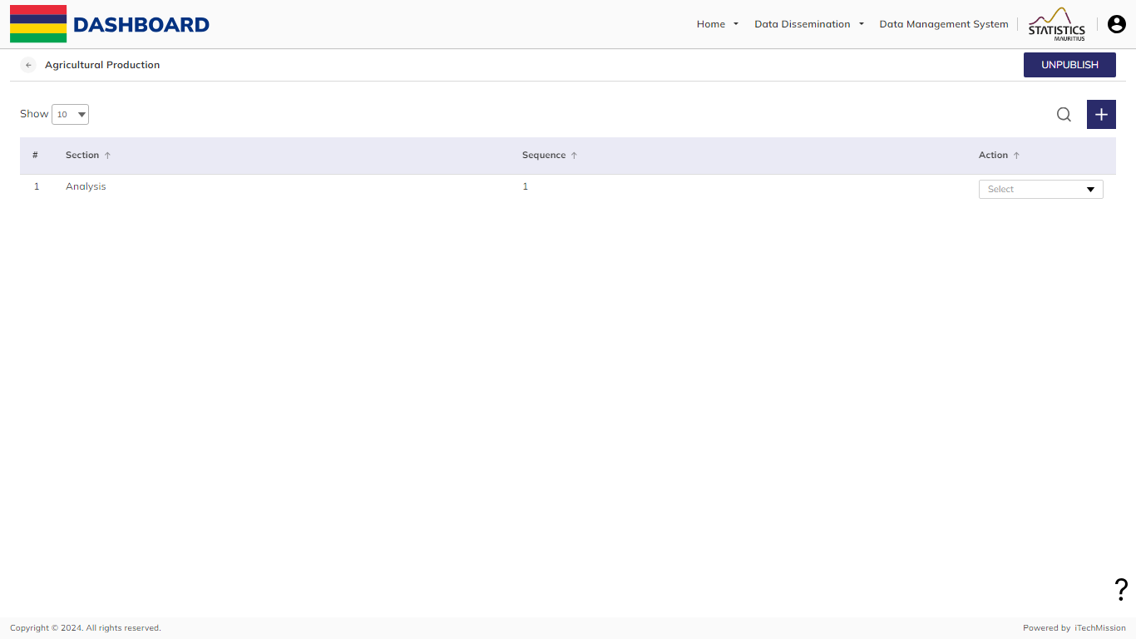
DASHBOARD
Click View to view sections. Then Click on the plus button to create a new section.

Slide 45
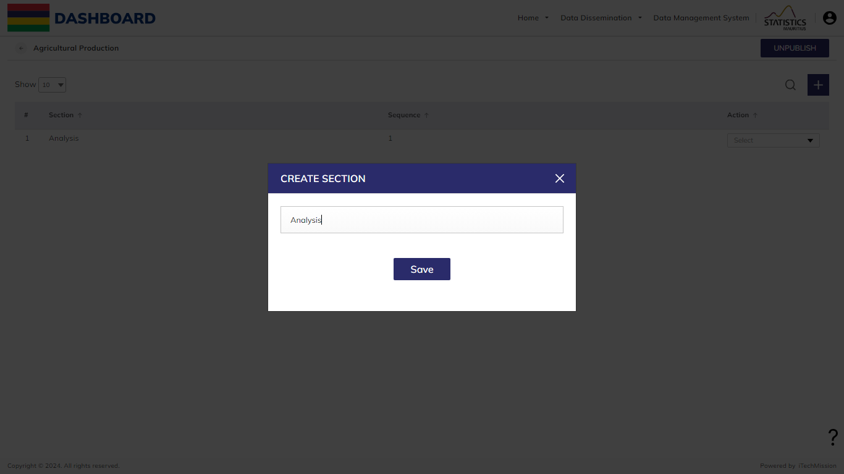
DASHBOARD
Enter the name and click on save to create a section.

Slide 46
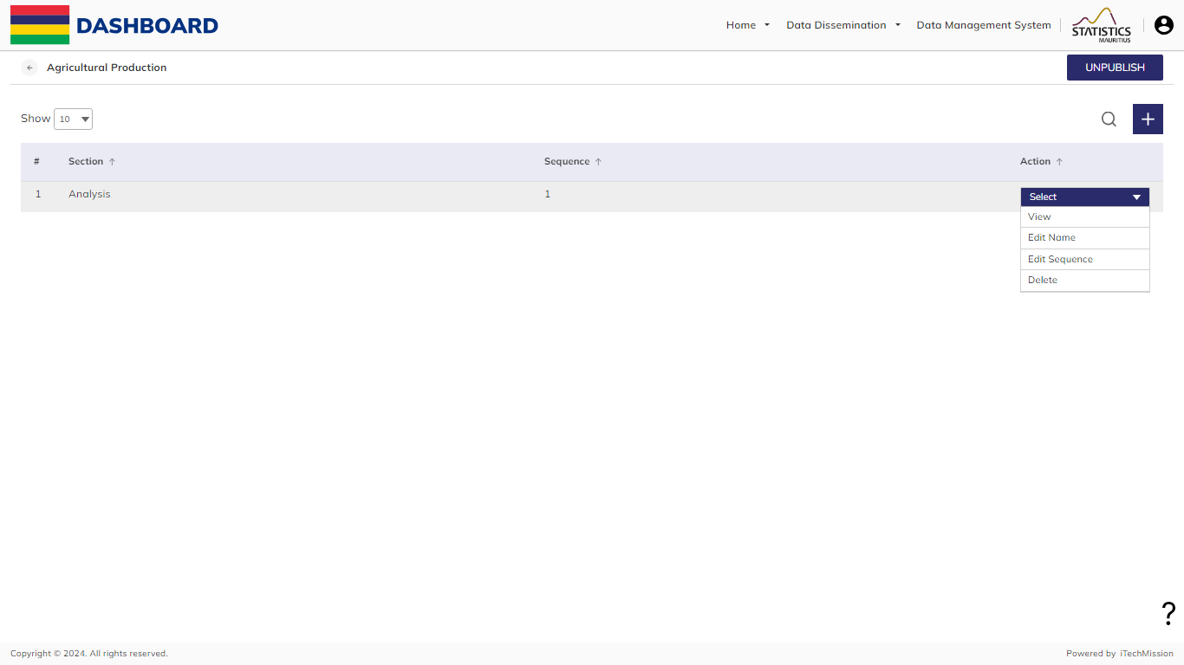
DASHBOARD
Click on the action dropdown option to View, Edit Name, Edit Sequence, and Delete the section.

Slide 47
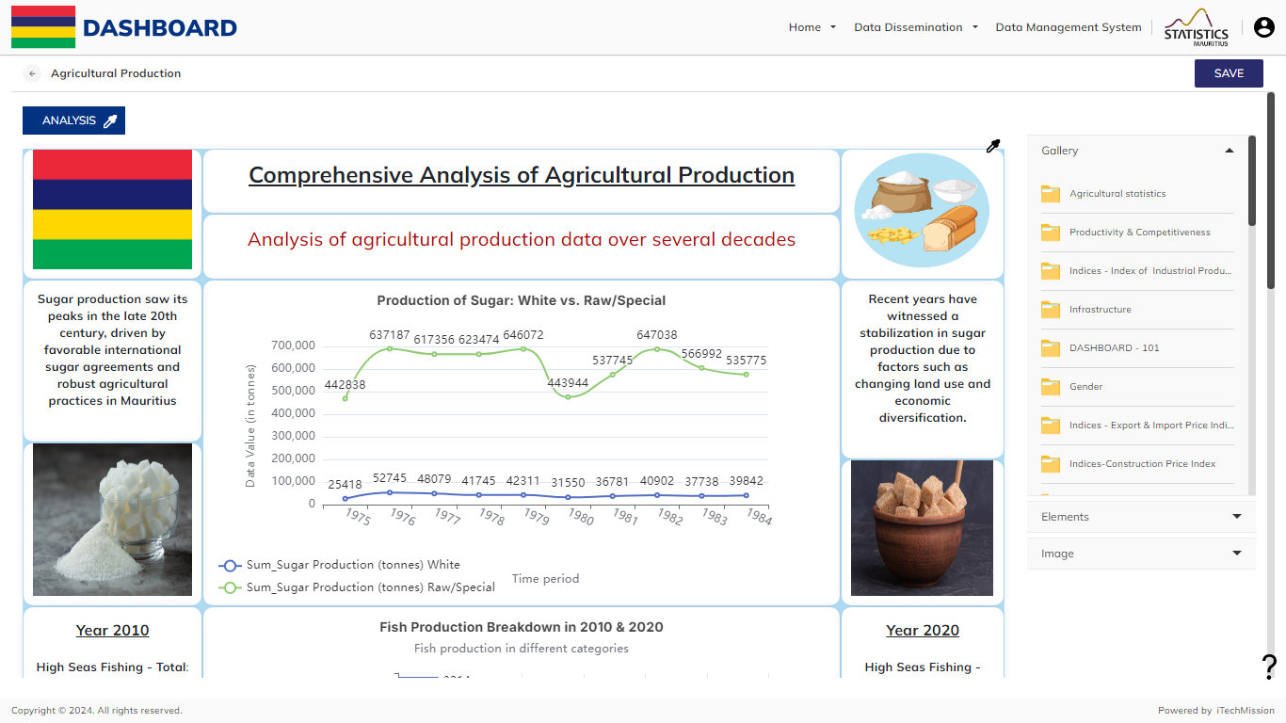
DASHBOARD
Select the visualization from the gallery folder.

Slide 48
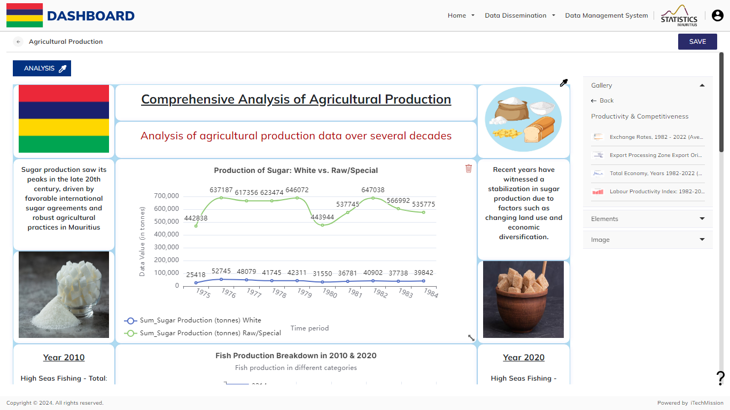
DASHBOARD
Drag and drop the visualization on the grey space.

Slide 49
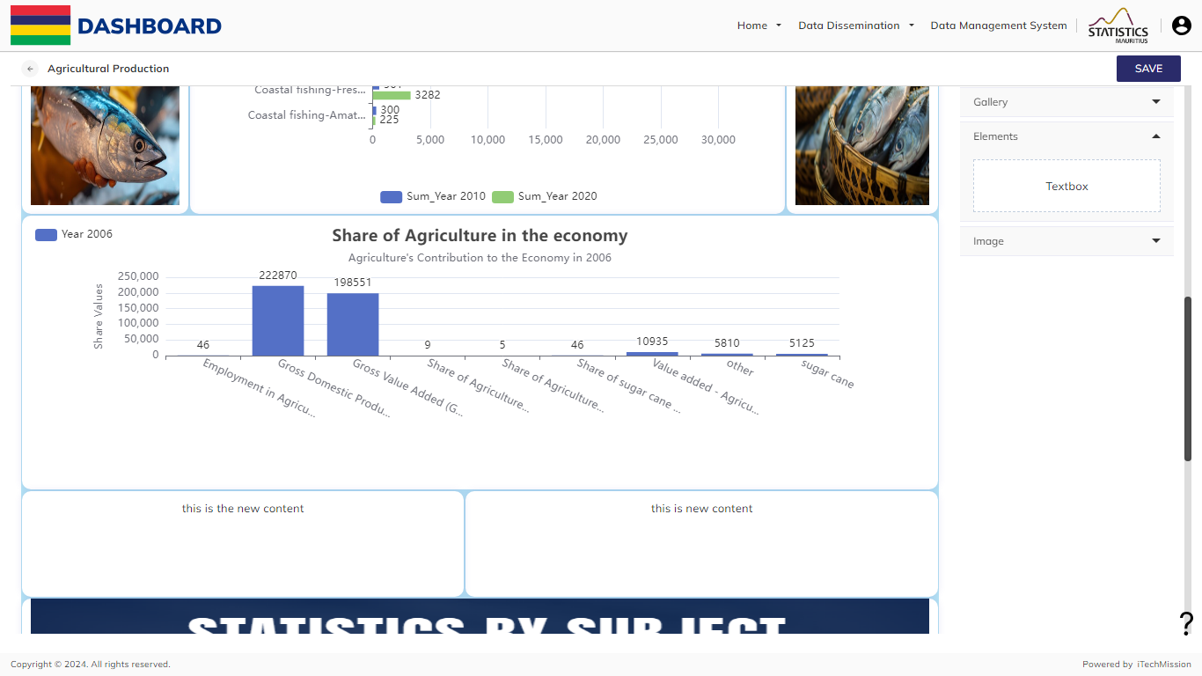
DASHBOARD
Drag and drop a text box if required from the add textbox option in the elements menu.

Slide 50
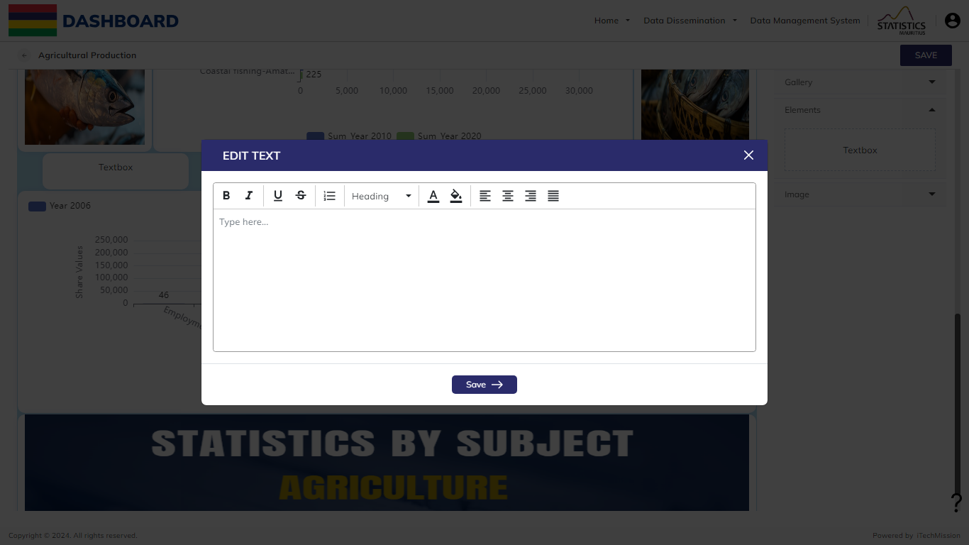
DASHBOARD
An Edit Text pop-up will appear, type the text required and format it accordingly. Click on the Save button to add the text.

Slide 51
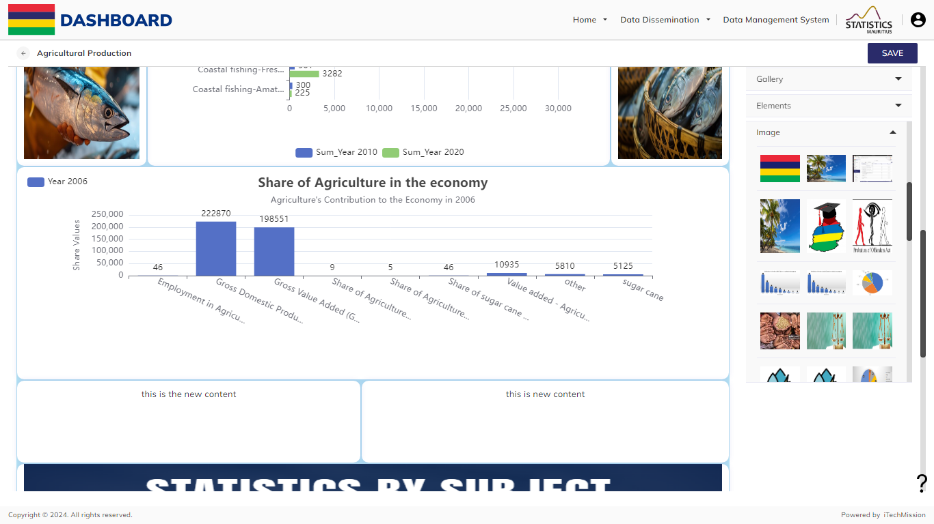
DASHBOARD
Drag and drop a image if required from image option in elements menu. (Select and upload the image if it not present)

Slide 52
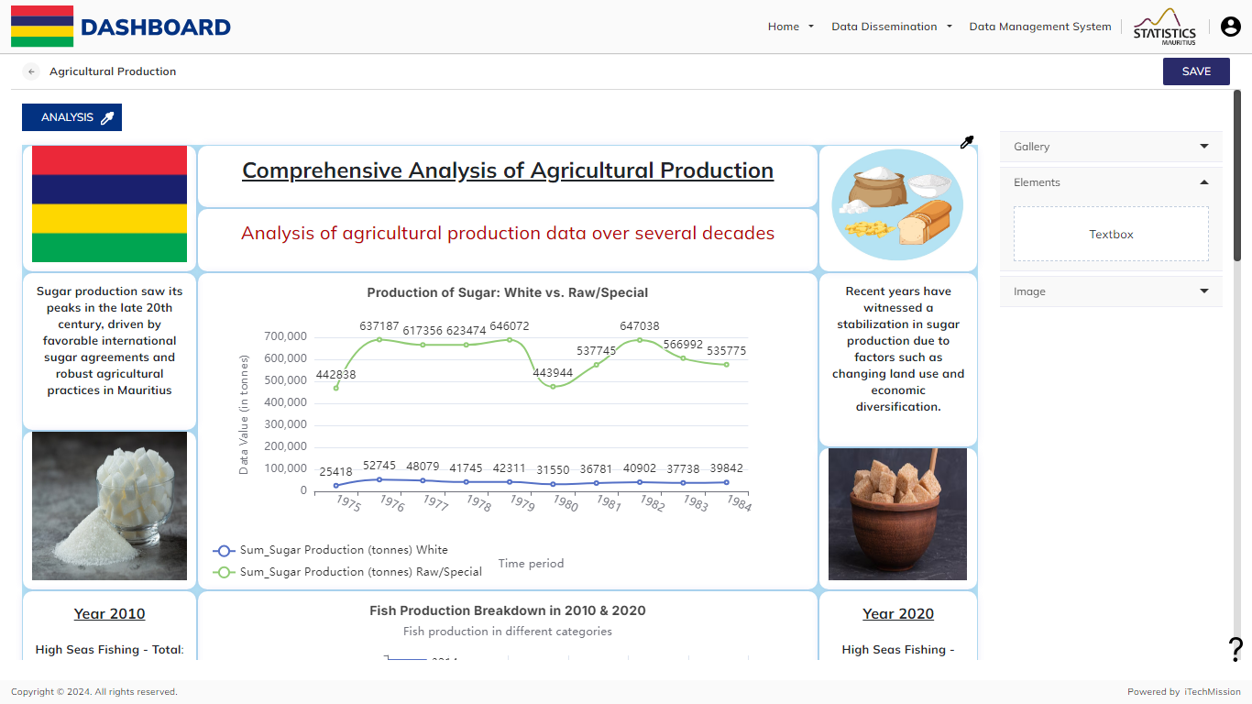
DASHBOARD
With the help of this fill button , you can change the background color.

Slide 53

DASHBOARD
Click on Save to save the sections.

Slide 54
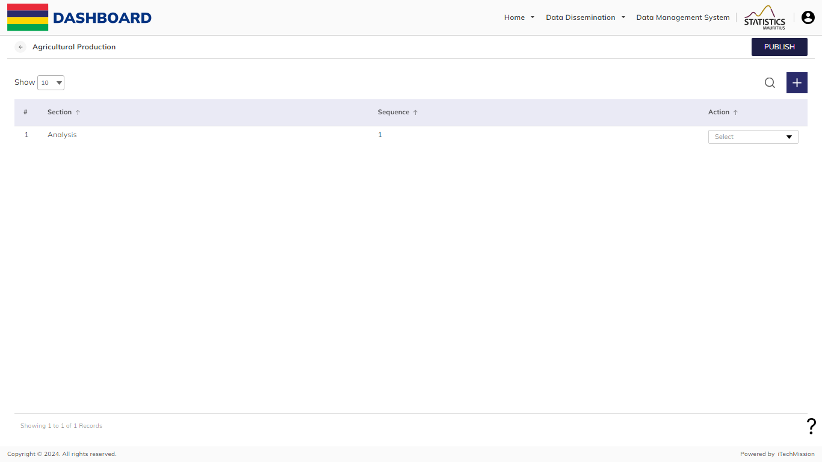
DASHBOARD
Click on publish to Publish the dashboard.

Slide 55
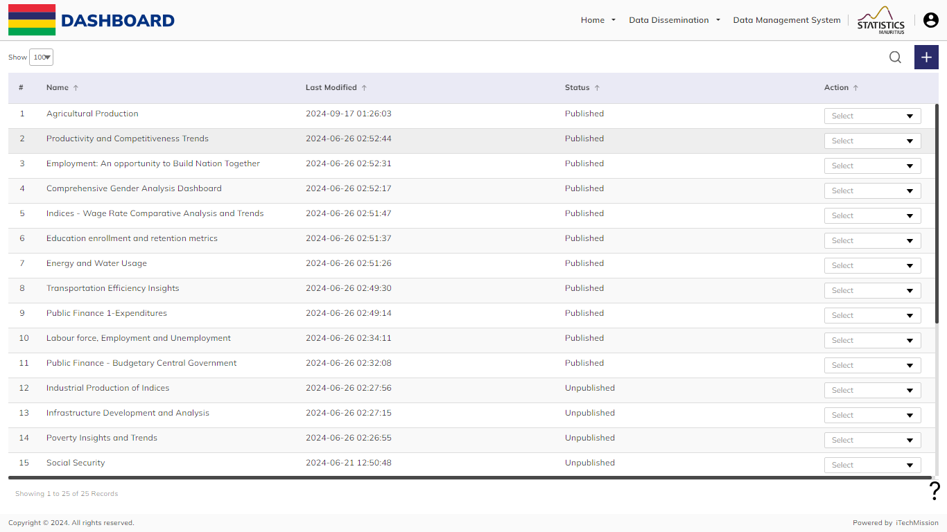
DASHBOARD
The dashboard is Published now.

Slide 56


